Slide 1
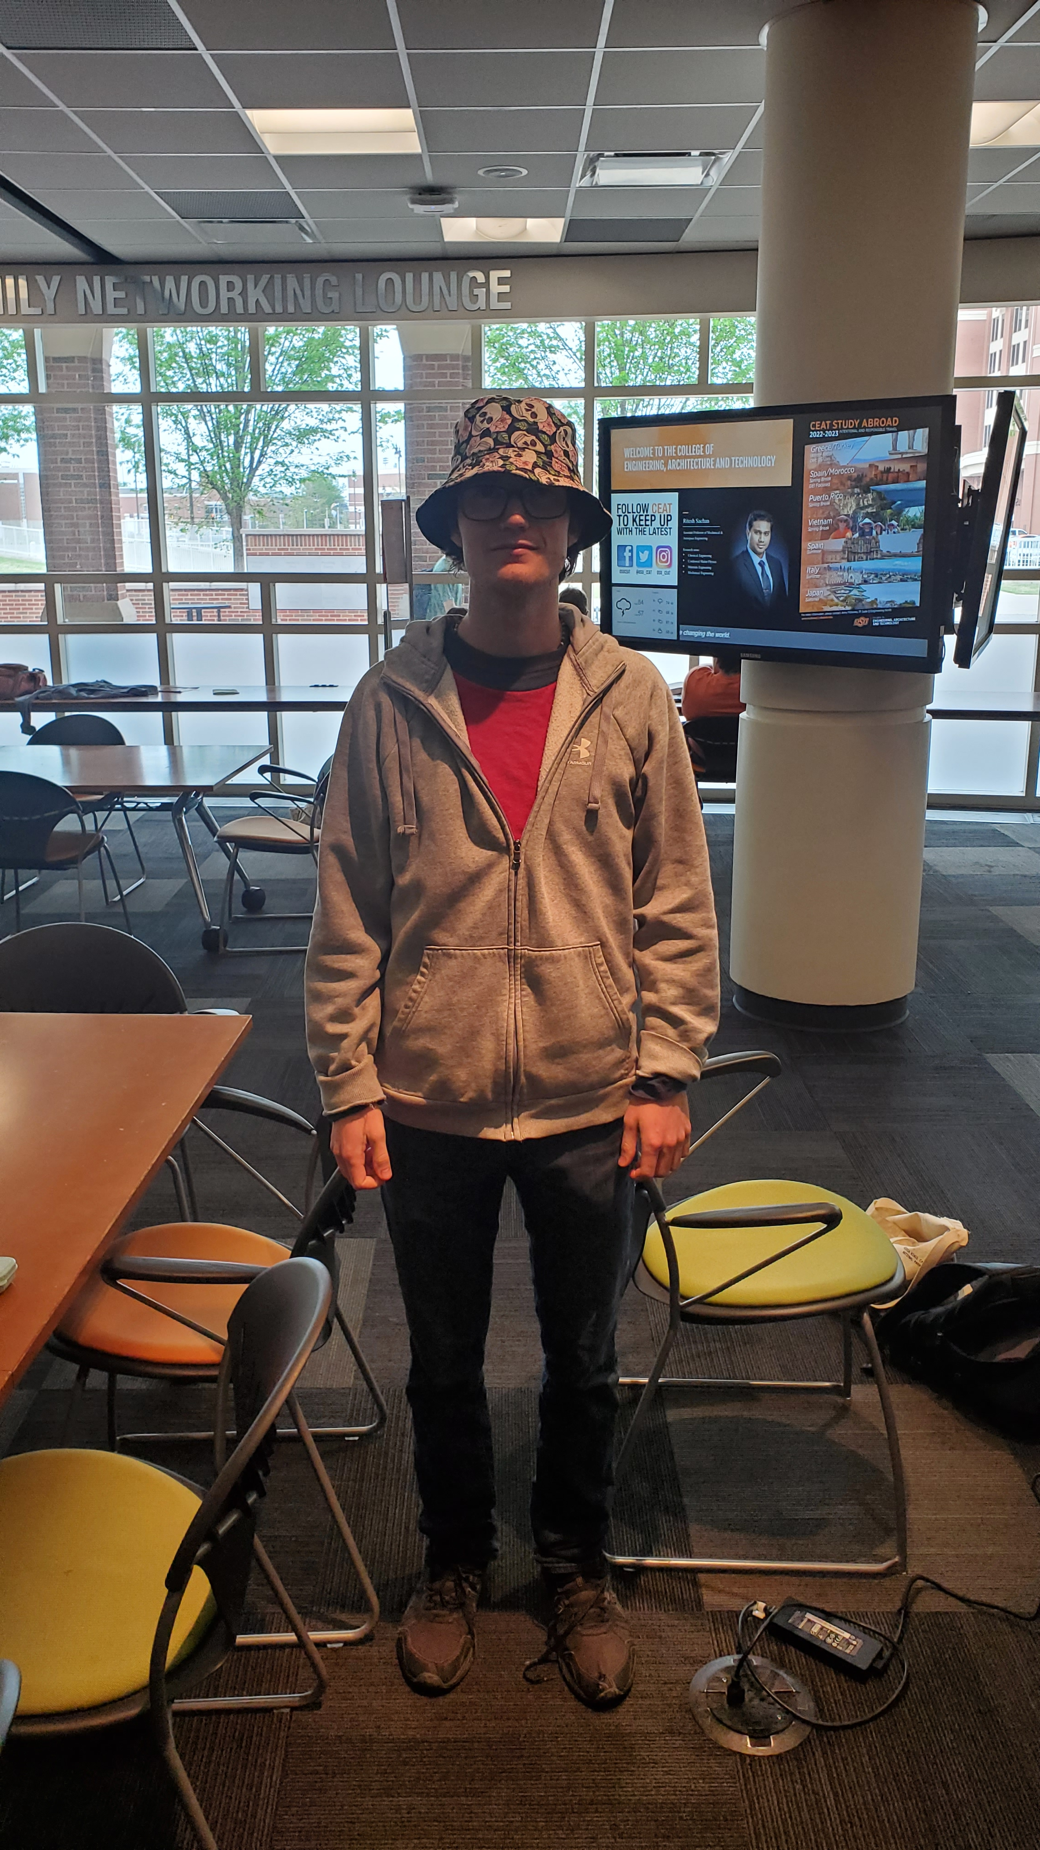

2023 Intern Introductions
Preferred Name | Thomas
Preferred Pronouns | He/Him
School and Major | Electrical and Computer Engineering @ Oklahoma State University
What is the best book you have read this year? | Dune by Frank Herbert
Internship | Electrical Engineering Intern
Location | Perry, OK
What are you looking forward to most out of your internship? | Learn how the production of electronics gets done in the real world.

